Slide 1



Subtopic N1.9 - Position Integers on a Number Line
LEARNING OUTCOME: Understand positive numbers and represent them on a number line
Objectives:
Keywords:
Positive
Integer
Number line
Ascending
Recognise the order of positive integers.
Order positive integers and represent them on a number line.
Apply to contextual questions.
Introduction – Read and annotate:
Positioning integers on a number line helps us understand where numbers sit in relation to each
other and how to estimate their positions between marked points. It also introduces the idea of
midpoints, which deepens our number sense and sets a solid foundation for rounding in the next
section.
Definition
Characteristics
All integers which appear to the right of the 0 on a number line.
Greater than 0.
The larger integer means that the number is larger.
Examples
Positive Integers
Converting a percentage to a decimal – Examples
These numbers are all positive and all integers.
Non - Examples
4
13
126
Completing number lines and calculating midpoints
Steps | Look at the increments that the scale is increasing by. Use this to complete the number line. To find the midpoint, add the two numbers together and divide by two.
Example 1 – I do Fill in the missing values on the number line. The arrow indicates the midpoint of two values. Calculate this.
Example 2 – We do Fill in the missing values on the number line. The arrow indicates the midpoint of two values. Calculate this.
Example 3 – You do Fill in the missing values on the number line. The arrow indicates the midpoint of two values. Calculate this.
97
98
101
102
97.5
260
280
255
500
520
560
590
525

Slide 2



Independent Practice
Question 1. Fill in the missing values on the number line and calculate the midpoint of the two values either side of the arrow.
a)
b)
c)
d)
e)
f)
g)
h)
i)
j)
3
4
3.5
60
70
80
65
20
25
30
35
27.5
500
600
700
550
910
920
950
960
970
980
955
50
100
150
400
450
175
1800
2000
2200
2400
2600
2350
18
20
22
24
26
18.5
260
270
300
310
265
305
250
300
450
500
600
650
475

Slide 3
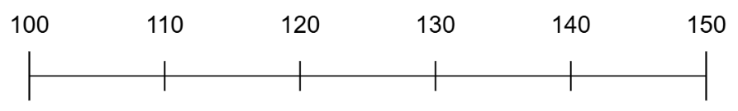
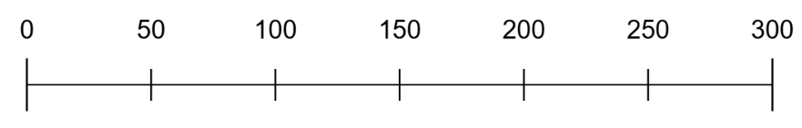
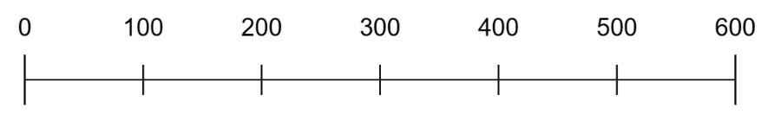
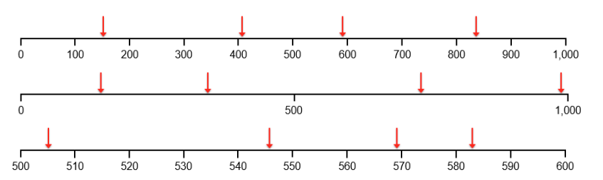
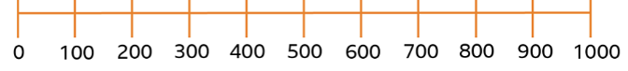
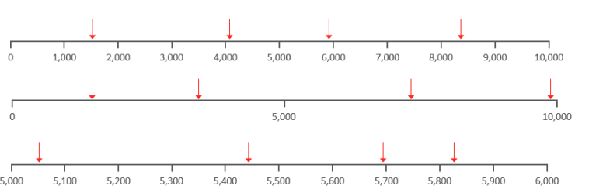
Estimate, label and draw numbers on number lines
Steps | Identify the two values on the number line that the number we are estimating lies between. Consider the midpoint. Will the value we are estimating be above or below this?
Example 4 – I do Mark with an arrow an estimate for 123.
Example 5 – We do Estimate the number indicated by the arrow.
Example 6 – You do Mark with an arrow an estimate for 380.
165
Independent Practice
Question 2. Label the arrows with estimated values, then mark an arrow to estimate the given value.
*Allow a range of estimates*
150
410
590
840
a) 970
b) 690
c) 557
d) 3400
970
220
550
880
690
505
546
569
583
557
1500
4100
5900
8400
3400

Slide 4
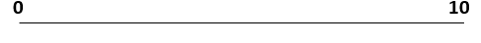
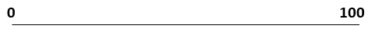
e) 5230
f) 38
g) 600
h) 8600
5050
5230
5440
5699
5825
14
21
32.5
38
140
360
750
9995
600
1300
3600
7500
9990
8600
Question 3. Answer the following questions:
a) Where would the number 6 be on this number line?
b) Where would the number 2 be on this number line?
c) Where would the number 50 be on this number line?
d) Where would the number 70 be on this number line?
e) Where would the number 20 be on this number line?

Slide 5
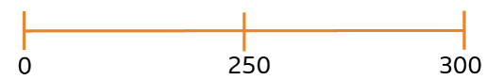
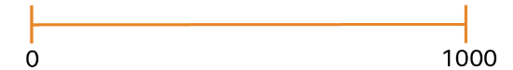
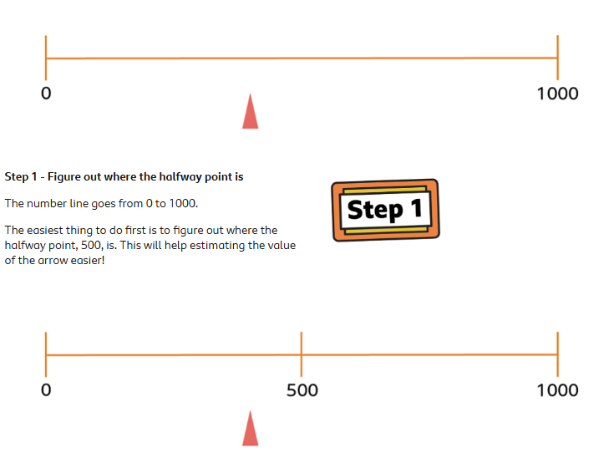
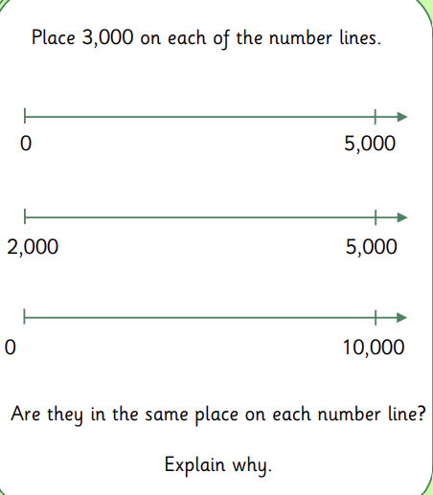
f) Where would the number 89 be on this number line?
g) Where would the number 35 be on this number line?
h) Write down an estimate for the number at the arrow
i) Write down an estimate for the number at the arrow
j) Write down an estimate for the number at the arrow
k) Write down an estimate for the number at the arrow
l) Where would the number 3000 be on this number line?
m) Where would the number 3000 be on this number line?
n) Where would the number 3000 be on this number line?
260
900
350
450

